Slide 1

Finding lands to construct apartment buildings in colombo
CHATHUSHA KARUNATHILAKE

Slide 2
Finding lands to construct apartment buildings is important for developers
Generally, value of apartment and market for apartment building mainly depend on the facilities available in the building and nearby infrastructures and facilities.
So, it is important to find lands near appealing infrastructures and facilities.
With basic understanding about where to watch for land will give the developers great advantage.
Clients will also have some interest on this project.

Slide 3
Data acquisition and cleaning
Neighborhood data of Colombo district from Department of Census and Statistics, Sri Lanka.
Location data of each neighborhood from Google Maps API.
Nearby venue data from Foursquare API.
PDF tables were converted to CSV format.
Nearby venue data was collected under 11 categories.

Slide 4
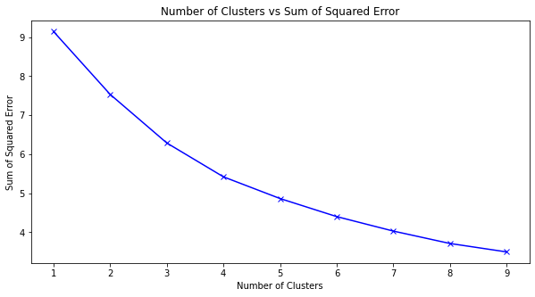
Modeling
K-Means clustering method was used to cluster each location based on nearby venues.
Elbow method was used to identify the number of clusters.

Slide 5
Conclusion
Out of 577 neighborhoods evaluated, 80 neighborhoods were identified as best locations to construct apartments.

